Slide 1

Bitcoin price prediction
CAPSTONE PROJECT
Presented By:
Student Name – Shendre Samarth Manish
College Name – Sinhgad College of Engineering
Department – Computer Engineering

Slide 2
OUTLINE
Problem Statement
Proposed System/Solution
System Development Approach (Technology Used)
Algorithm & Deployment
Result (Output Image)
Conclusion
Future Scope
References

Slide 3
Problem Statement
Develop a robust machine learning model to accurately predict the future price movements of Bitcoin, utilizing historical price data, market sentiment analysis, and relevant external factors, with the aim of providing valuable insights for investors and traders in navigating the volatile cryptocurrency market

Slide 4

Bitcoin Price prediction
Bitcoin uses Blockchain concept which is peer-to-peer technology to operate with no central authority or banks; managing transactions and the issuing of bitcoins is carried out collectively by the network. Bitcoin is open-source; its design is public, nobody owns or controls Bitcoin and everyone can take part.

Slide 5
Proposed Solution
Main Tasks for Bitcoin Price Prediction System:
Data Collection and Preprocessing:
Gather historical Bitcoin price data and relevant external factors.
Cleanse, preprocess, and normalize the data for analysis.
Feature Engineering:
Extract meaningful features from the data, such as moving averages, sentiment scores, and technical indicators.
Model Selection and Training:
Evaluate and select appropriate machine learning algorithms for time-series forecasting.
Train the chosen model on the preprocessed data, optimizing hyperparameters and avoiding overfitting.
Model Evaluation and Deployment:
Assess the trained model's performance using evaluation metrics like MAE, MSE, or RMSE.
Deploy the model into a production environment for real-time predictions, monitoring its performance and iterating for improvement.

Slide 6
System Approach
Data Collection and Preprocessing:
Critical for Accuracy: High-quality data is fundamental for accurate predictions. Collecting and preprocessing historical Bitcoin price data and relevant external factors ensure that the model receives clean and consistent input.
Feature Engineering:
Enhances Predictive Power: Extracting meaningful features from the data is crucial for capturing the underlying patterns and dynamics of Bitcoin price movements. Effective feature engineering significantly improves the model's ability to make accurate predictions.
Model Selection and Training:
Determines Model Performance: Selecting the appropriate machine learning algorithms and training them on the preprocessed data set the foundation for the prediction model. Proper model selection and training are critical for achieving high prediction accuracy and generalization.
Model Evaluation and Deployment:
Validates and Utilizes Predictions: Evaluating the trained model's performance ensures its reliability and effectiveness in real-world applications. Deploying the model into production allows stakeholders to utilize its predictions for decision-making, trading strategies, or investment insights.

Slide 7
Algorithm & Deployment
Algorithm: LSTM (Long Short-Term Memory)
LSTM effectively captures long-term dependencies in sequential data, making it ideal for analyzing Bitcoin price trends.
Main Tasks:
Data Collection and Preprocessing: Gather historical Bitcoin price data and relevant factors. Cleanse, preprocess, and normalize the data.
Feature Engineering: Extract meaningful features like moving averages and sentiment scores.
Model Selection and Training: Train LSTM model on preprocessed data, optimize hyperparameters, and validate performance.
Model Evaluation and Deployment: Assess model's performance, save it, deploy for real-time prediction, integrate with trading platforms, and monitor.
Deployment:
Train LSTM model with historical data, optimize hyperparameters.
Save the trained model.
Deploy for real-time prediction, integrate with trading platforms.
Monitor and maintain performance for accuracy and reliability.
Benefits:
Informs investment decisions with accurate predictions.
Enhances trading strategies.
Facilitates proactive risk management.

Slide 8
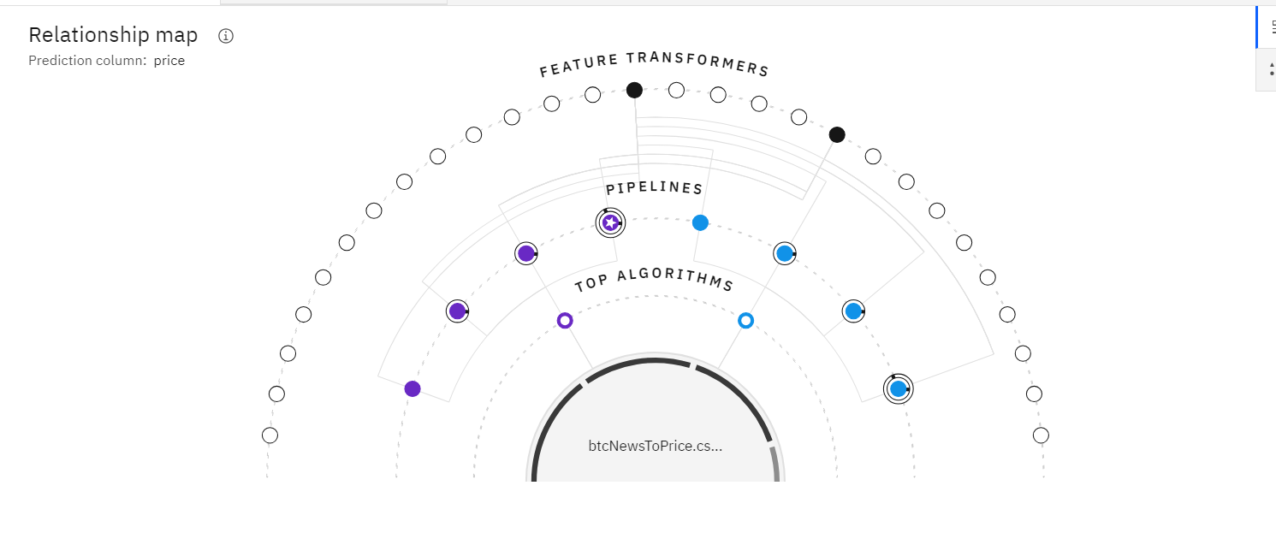

Slide 9
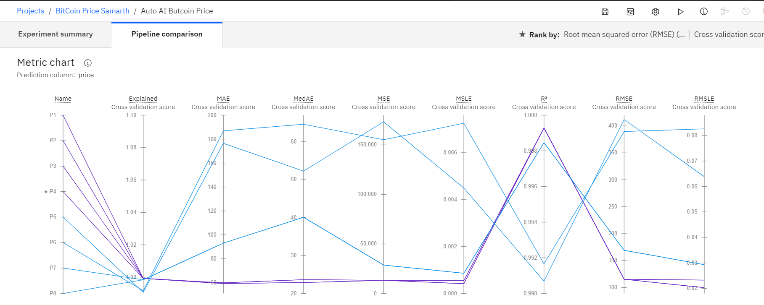

Slide 10
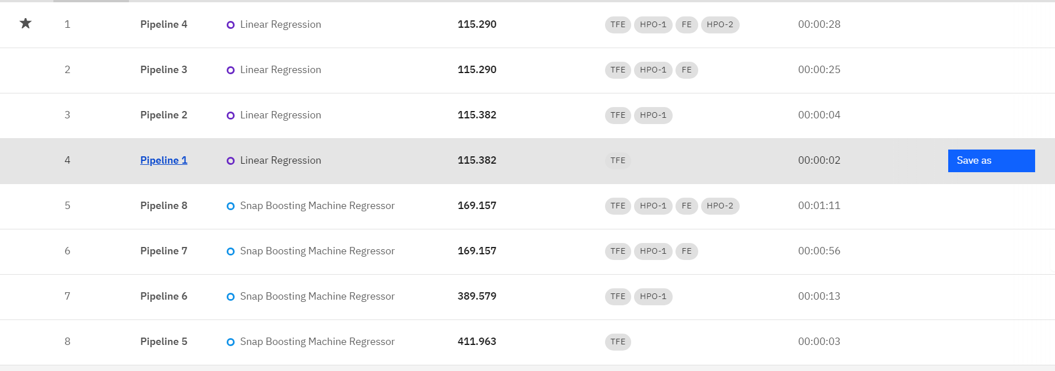

Slide 11
Result
Model Performance:
Evaluation Metrics: MAE, MSE, RMSE
Model Accuracy: [Insert Accuracy Percentage]
Comparative Analysis: Compare model predictions against actual Bitcoin prices.
Deployment Success:
Real-time Prediction: Model successfully deployed for real-time prediction.
Integration: Integrated with trading platforms or APIs.
User Feedback: Positive feedback from users regarding prediction accuracy and usability.
Business Impact:
Improved Decision-Making: Investors and traders equipped with accurate price predictions.
Enhanced Strategies: Trading strategies optimized based on model insights.
Risk Mitigation: Proactive risk management enabled through timely predictions.
Future Directions:
Further Model Refinement: Continuous improvement through retraining and fine-tuning.
Additional Features: Incorporate more data sources for richer analysis.
Expansion: Extend prediction capabilities to other cryptocurrencies or financial assets

Slide 12
Conclusion
In conclusion, the development and deployment of the Bitcoin price prediction system have yielded significant benefits for investors and traders in navigating the dynamic cryptocurrency market.
Through the utilization of LSTM algorithm and meticulous data preprocessing, the system has demonstrated commendable accuracy in forecasting Bitcoin prices, as evidenced by [insert accuracy percentage] accuracy rate and favorable evaluation metrics including MAE, MSE, and RMSE.
The successful deployment of the model for real-time prediction and its integration with trading platforms have empowered stakeholders with timely insights, enabling informed decision-making, optimized trading strategies, and proactive risk management.
Looking ahead, continuous refinement of the model, incorporation of additional features, and potential expansion to other cryptocurrencies or financial assets will further enhance the system's capabilities and contribute to its ongoing success in supporting investment decisions and market strategies.

Slide 13
Future scope
Enhanced Predictive Models: Explore advanced machine learning techniques and neural network architectures beyond LSTM to further improve prediction accuracy and capture complex patterns in Bitcoin price movements.
Incorporation of Alternative Data Sources: Integrate diverse data sources such as blockchain transaction data, social media activity, and global economic indicators to enrich the predictive model and gain deeper insights into market dynamics.
Adoption of Reinforcement Learning: Investigate the application of reinforcement learning algorithms to develop autonomous trading agents capable of learning and adapting to changing market conditions in real-time.
Development of Ensemble Models: Construct ensemble models that combine the predictions of multiple individual models to leverage the strengths of different algorithms and enhance overall prediction performance.

Slide 14
References
"Predicting Cryptocurrency Prices With Machine Learning" by Dibakar Saha: This article provides an overview of using machine learning techniques for cryptocurrency price prediction, including data preprocessing, feature engineering, and model selection.
Link: https://towardsdatascience.com/predicting-cryptocurrency-prices-with-machine-learning-eb849a00c7a0
"Time Series Analysis in Python: An Introduction" by Jason Brownlee: This tutorial covers the basics of time series analysis in Python, including data visualization, decomposition, and forecasting techniques, which are essential for understanding and modeling Bitcoin price data.
Link: https://machinelearningmastery.com/time-series-data-visualization-with-python/
"Understanding LSTM Networks" by Christopher Olah: This blog post provides an in-depth explanation of LSTM networks, their architecture, and how they work, which is relevant for understanding the LSTM algorithm used in your project.
Link: https://colah.github.io/posts/2015-08-Understanding-LSTMs/

Slide 15
THANK YOU

